Slide 1
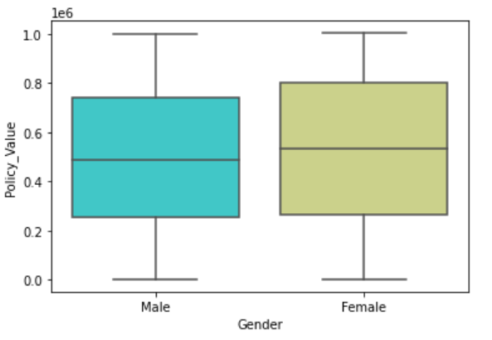
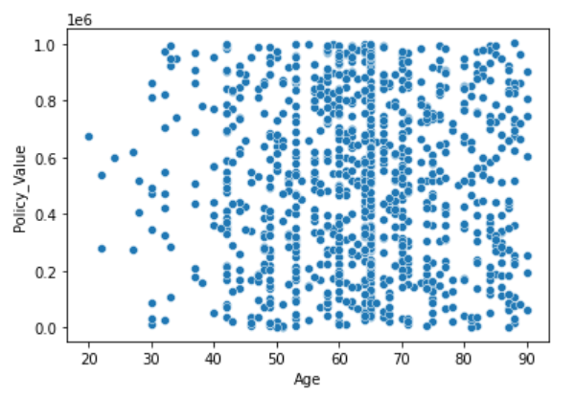
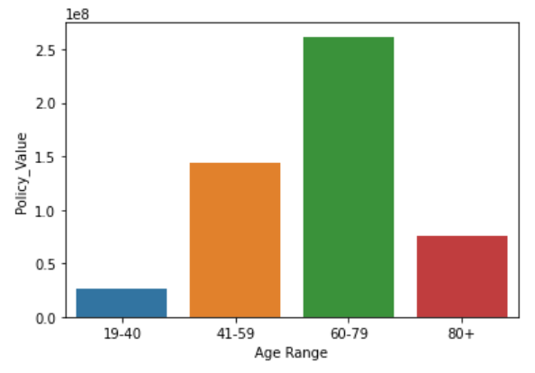
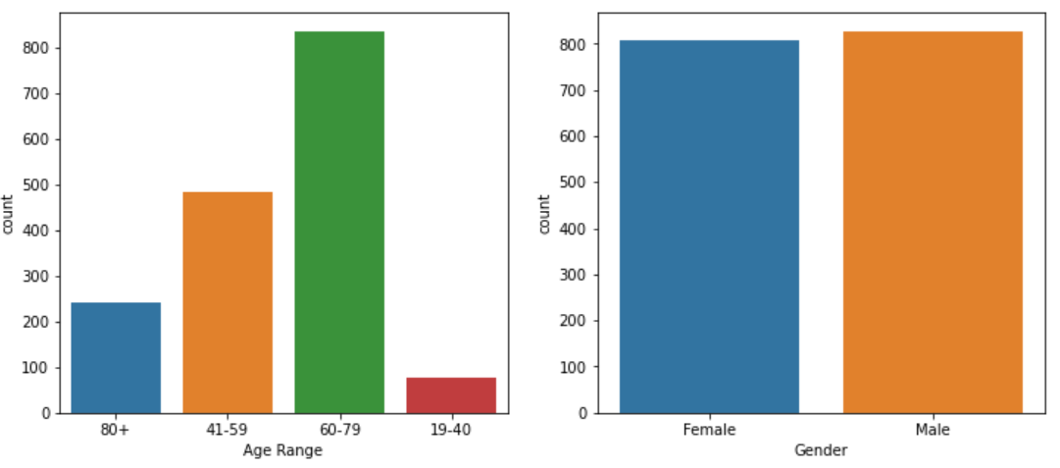
Pru Wealth Data EDA

Slide 2
Observations
Table Structures
Customer_Table (Rows: 999, Columns:6)
Policy_Table (Rows:1,635, Columns: 7)
Fund_Table (Rows: 72,121, Columns: 7)
as

